Slide 1



Lecture 5: Networking with Game Engines
COMP280: Creative Computing
BSc(Hons) Computing for Games
BA(Hons) Game Development: Programming

Slide 2


Slide 3
Learning outcomes
Configure Unreal Engine to support HTTP
Integrate JSON functionality into Unreal Engine
Develop a simple Unreal Engine application to show GET & POST functionality
Extend your Unreal Engine testbed for a real application

Slide 4
Key Full stack Technologies
Client
Server
View
(Python/PyQt)
(Unreal)
Data Comms
(HTTP / JSON)
Controller
(Python)
Model
(SQL/Sqlite)

Slide 5
Key Full stack Technologies
Last week:
Looked at broad Python-based client-server architecture
Addressed issues with JSON for better data transfer
SQL for persistent data management
→ Basis of a powerful backend framework

Slide 6
This week
Game engine integration approaches
Game & Architectural design considerations

Slide 7
Unity Integration

Slide 8
Unity Integration
Unity leverages C# & .NET as its run-time architecture
.NET is very good for client/server development
Often used as an alternative to Python
Choice is often:
Python (bespoke / Django)
C# (.Net / ASP.NET)
JavaScript (bespoke / Node.js)

Slide 9
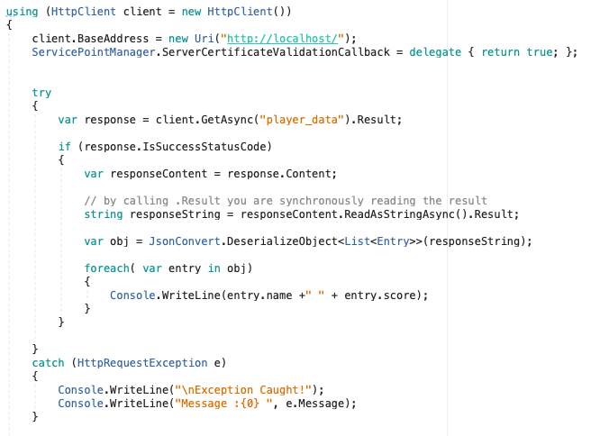
Unity Integration
Generic C# HTTP Client functionality
Functionally identical to Python
GetAsync() is ‘GET’
Slightly more code, Python is more geared towards rapid development
Python uses 3rd party s/w for JSON support
Newtonsoft
Typed nature of C# combined with refection makes JSON relatively easy to work with

Slide 10
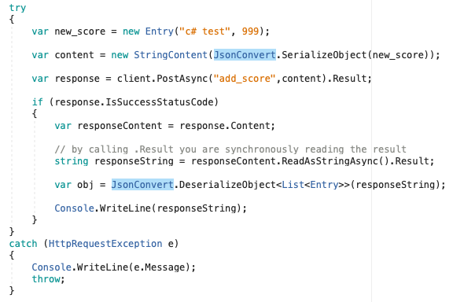
Unity Integration
Generic C# HTTP Client functionality
Functionally identical to Python
PostAsync() is ‘POST’
Slightly more code, Python is more geared towards rapid development

Slide 11
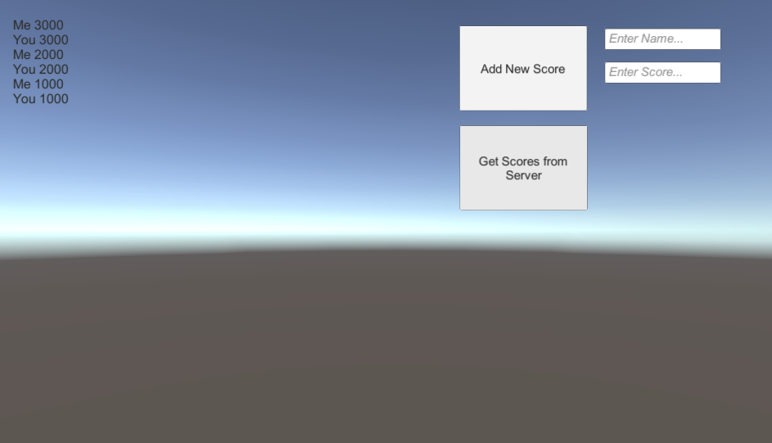
Unity Integration
Generic C# HTTP Client functionality
Can take this straight into Unity project

Slide 12
Unity Integration
Create a UI with:
A multi-line textbox to display score info
A button widget to get scores from the server
A button widget to send score to the server
2 text input widgets to enter name + score for new data

Slide 13
Unity Integration
Create a UI with:
Add Score Button
Uses OnClick()
Calls scorewidget.AddScore
Get Scores Button
Uses OnClick()
Calls scorewidget.GetScores()
These functions call the standalone .NET code from before
Also copy data for AddScore
And paste data into textbox for GetScores

Slide 14
Unreal Integration

Slide 15
Unreal Integration
Works in much the same way
However, uses Unreal C++ wrapper code to deal with:
HTTPClient
JSON data
Unreal ‘documentation’
https://wiki.unrealengine.com/Http-requests
Create an actor derived class to hold requests and associated responses
‘broadly’ similar to Unity approach

Slide 16
Unreal Integration
HTTP data definitions

Slide 17
Unreal Integration
HTTP data transfer (GET)
GET (GetRequest)
Uses ‘subroute’ as a command
Passes response function to be called on completion

Slide 18
Unreal Integration
HTTP data transfer (GET)

Slide 19
Unreal Integration
HTTP data transfer (POST)
POST (PostRequest)
Uses ‘subroute’ as a command
Passes response function to be called on completion
Passes specific send data as json

Slide 20
Unreal Integration
HTTP data transfer (POST)
Response
Unpack JSON response (this is unrelated in this instance)

Slide 21
Unreal Integration
Unreal’s JSON engine doesn’t support anonymous collections
Will silently fail with errors logged in output log
(window->developer tools->output log)
Add a label to contain data

Slide 22
Unreal Integration
Unreal’s HTTP engine will fail without trailing / in url
Just reports that server rejected connection

Slide 23
In general
Typed languages (C# & C++) lose the immediacy (and speed of development) of Python
As JSON data needs to be made explicit
Need to think about your data transfer formats
Cost in changing it between client and server
POST
Transmit & receive data
GET
Receive data only
Embed data into subroute / path and unpack

Slide 24
In general
GET data
Embed using <subroute>?<label>=<value>&<label>=<value>
No spaces, = or & in labels & values (use ascii %20 etc)
Unpack with urlib.parse
Becomes a dictionary of values

Slide 25
Conclusions
HTTP /JSON is are fine transport & data layers
Works with Python, C# / C++ / Unity / Unreal
Moving from untyped (Python) to typed (C# / C++) creates complications
Particularly with JSON
These are soluble, but be aware of scope for failure / issues
Scope for issues (Unity) with time to complete HTTP requests
Threading / yield are solutions

Slide 26
Questions

